Slide 1
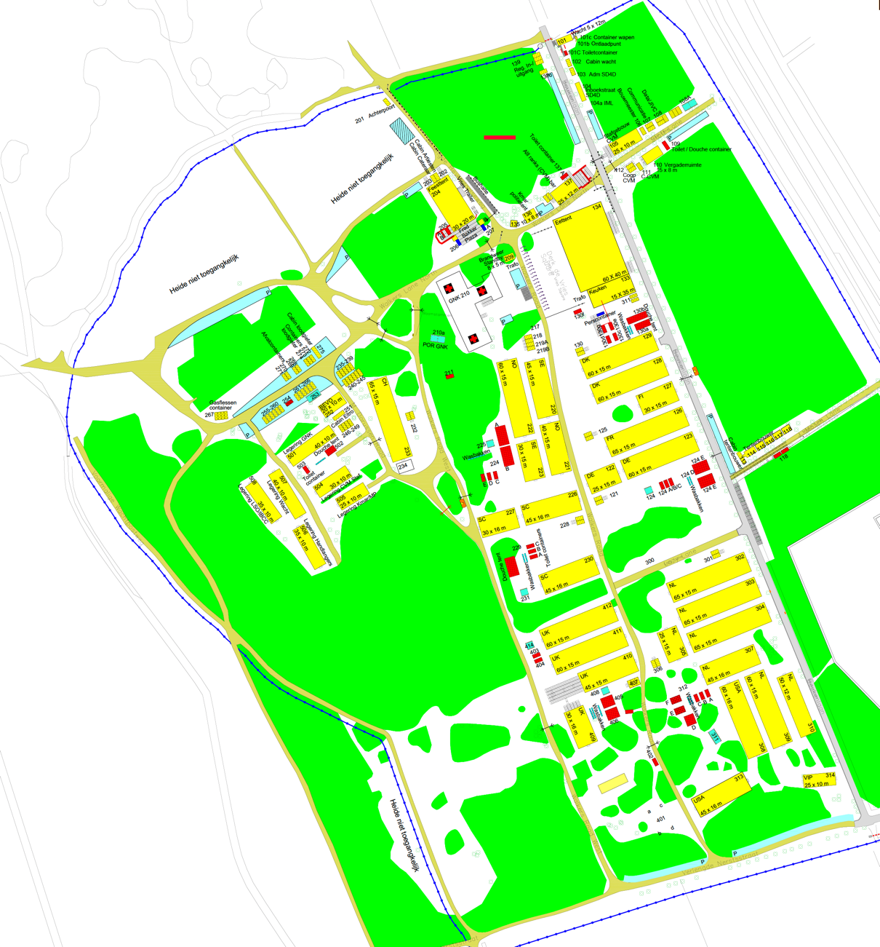
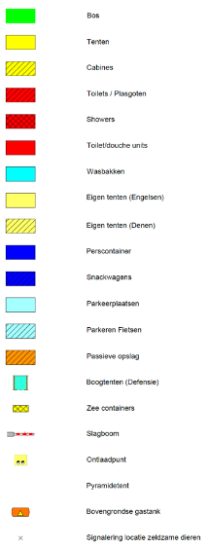
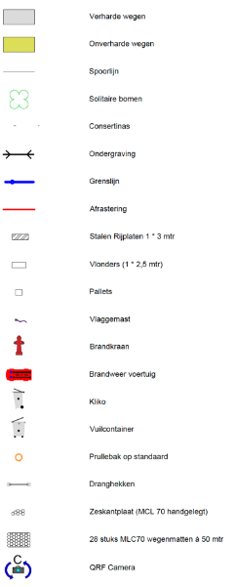
Kamp Heumensoord
Key Locations
Camp Main Entrance
Registration
Boots’n’Helmet Gate
Dining Facility (Bldg. 134)
U.S. Delegation Office (Bldg. 306)
U.S. Charging/Briefing Tent (Bldg. 311)
U.S. Delegation Bldg. 308 (18 bays/288 beds)
U.S. Delegation Bldg. 313 (14 bays/224 beds)
UK Delegation Bldg. 410 (06 bays/096 beds)
Toilets, Wash Troughs / Showers (Bldg. 312)
Hospital (Bldg. 210)
Beer/Party tent (Bldg. 204)
1
LEGEND
1
2
2
3
4
3
5
12
6
4
7
8
11
9
10
11
12
NOTES:
- no laundry facilities
- no ATM for cash, beer tent ATM is for food/beer tokens
- lights-out ca. 2100
- garbage dumpsters on-site – use them
- I SAY AGAIN: KEEP YOUR AREA CLEAN
5
9
10
7
6
8
U.S. area / facilities
N
as of 20240517

