Slide 1

Indoctrination Brief
4Daagse 2024, 16-19 July
USDNM Volunteers
Christopher Bulger
Mary Merson
Friday 10 MAY 2024
2000 UTC+1 https://www.usnijmegenmarch.com
U.S. Delegation Nijmegen March (USDNM)

Slide 2
Agenda
1. Administrative Preliminaries
  1.1. The Vierdaagse “Nijmegen”
  1.2. Mission
  1.3. Indoctrination brief purpose
2. Camp Heumensoord
  2.1. Location
  2.2. Transportation
  2.3. Camp Orientation
  2.4. ”Sustainment Load” Packing List
3. The March
  3.1. Timeline / Uniform / Duty Status
  3.2. Routes
  3.3. Protocol / Etiquette / Alcohol Policy
  3.4. “Fighting Load” Packing List
4. Training
4.1. Training approaches
4.2. References
4.2. Considerations
5. Execution
5.1. Warm-up
5.2. Resting
5.3. Cool-down
APPENDICES
A. Consolidated Packing List
B. Training References
C. Other Marching Events
*Not covered on 20240503:
- safety brief, more to follow sooner to event
- administrative on adding award to permanent military record (sorry Navy and Marines… Space Force?)
as of 20240510

Slide 3
1. Administrative Preliminaries
1. The Vierdaagse “Nijmegen”
- The world’s largest march: 39K civilian; 6K military; 550 U.S. of all services, components, branches, and geographies
- Established in 1909 as a military readiness/fitness event. 2024 is the 106th event.
- In WWII, Nijmegen was involved in OPERATION MARKET GARDEN. Nijmegen is part of U.S. military history and heritage.
- U.S. participated during cold war, but waned during War on Terror. U.S. participation has resurged in recent years.
2. Mission (suggested)
2.1. Prove ability to train and maintain fitness (Note: this is NOT to test yourself – that’s what training is for.)
2.2. Represent the U.S. Military in a multinational public setting.
2.3. Have fun.
3. Indoctrination brief purpose
- Dutch and International Community readily welcome U.S. participation… but we don’t (always) perform as expected.
- U.S. military needs to meet marching standards.
- This brief intends to provide baseline information to Nijmegen specifically and training in general for U.S. success.
- We refer to volunteer experience of past marches and U.S. Army doctrine.
- The brief follows a “narrative” structure, not subject priority. Some information is summarized in appendices.
- No questions during the brief. Please post questions to the Zoom chat. We’ll address questions after the brief.
as of 20240510

Slide 4
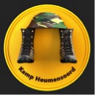
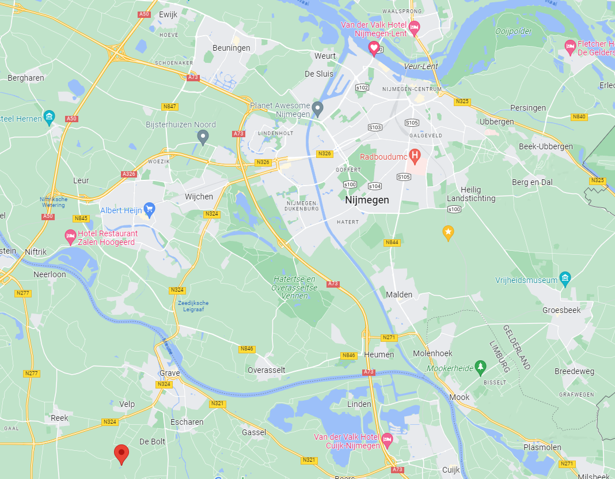


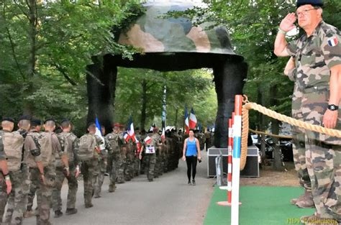
2. Camp Heumensoord
https://www.facebook.com/KampHeumensoord
2.1. Location, main gate: 51.80291, 5.87622
- Camp entry and check-in opens 1100 on Saturday prior to march (13 July 2024).
- NO PARKING at Heumensoord.
- Limited load/unload capacity at gate,
please coordinate with delegation
prior to off-loading.
2.2. Transport to Heumensoord
Personal Vehicle (POV) parking available
in Grave-Driehuis at
Zandvoortseweg 6, 5375 JA, REEK
- Location: 51.731233, 5.713213
- 30 minute or longer shuttle bus between
parking and Heumensoord during
arrival/departure days
- A shuttle bus runs between Heumensoord and Nijmegen center, too.
Camp Heumensoord
Personal Vehicle Parking
as of 20240510

Slide 5
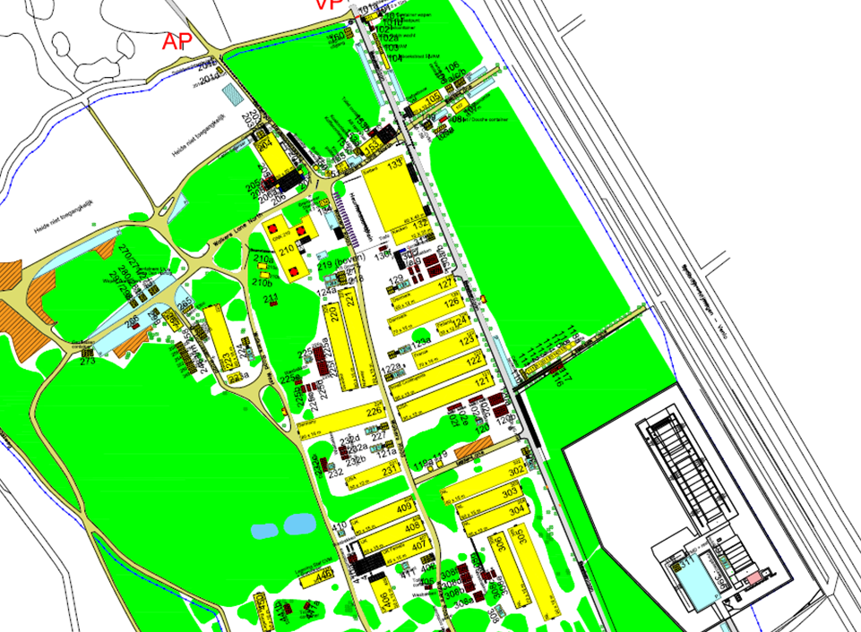

2. Camp Heumensoord
2.3. Orientation
Camp Main Entrance
Registration
Boots’n’Helmet Gate
Dining Facility
U.S. Delegation Office (Bldg. 121 a)
U.S. Charging Tent (Bldg. 232 a/b/d)
U.S. Delegation individual billeting
U.S. Delegation team billeting
Toilets w/ wash troughs
Showers
Hospital (Bldg. 210)
Beer/Party tent (Bldg. 204)
1
1
2
2
3
3
4
TBD
TBD
12
TBD
4
TBD
#
11
#
11
12
NOTES:
- no laundry facilities
- no ATM for cash, beer tent ATM is for food/beer tokens
- lights-out ca. 2100
- garbage dumpsters on-site – use them.
- I SAY AGAIN: KEEP YOUR AREA CLEAN
as of 20240510

Slide 6
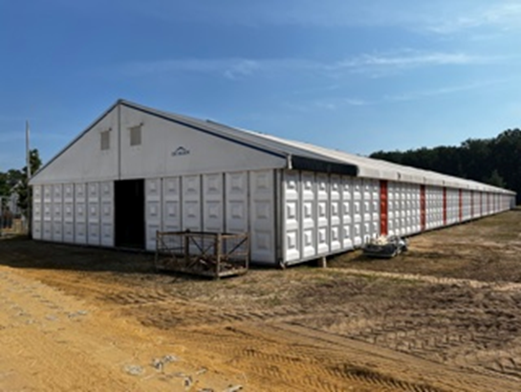
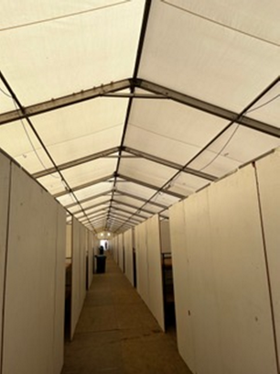
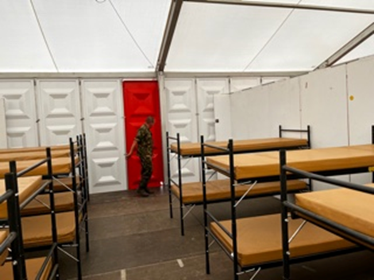
2. Camp Heumensoord
Bunk Set-up
2.4. ”Sustainment Load” Packing List
Necessities
- sleep system
- toiletries
- 2x bath towels
- shower shoes
- 1x casual clothes with shoes
- 1x sport clothes with running shoes
- head lamp
For personal bunk space
- stuff sacks with carabiners for hanging
- laundry bag(s)
- bungee or 550 cord
- coat hangars and/or clothing clips (laundry space is limited, so be efficient)
Highly Recommended
- 1x “recovery” shoes - old house or
gym shoes - something airy, dry, comfy
- 4x full uniform
Common utility
- trash bags: remembered last, wanted first
- large pool for foot bath (w/ Epsom salt)
- bed sheet to screen hallway door
- foam roller for shin/back stretching
Sundries
- trade items – uniforms, flags, patches, etc.
- field chair
Shelter is provided everyday; barracks are erected with bunk beds. The Rooms are separated by teams and are co-ed. Some bays are female-only. There is strong Wi-Fi signal throughout the camp. Showers, latrines with running water and sinks are provided on camp for personal hygiene.
You will need to bring a sleeping bag, pillow and toiletries. Everything else is taken care of.
as of 20240510

Slide 7
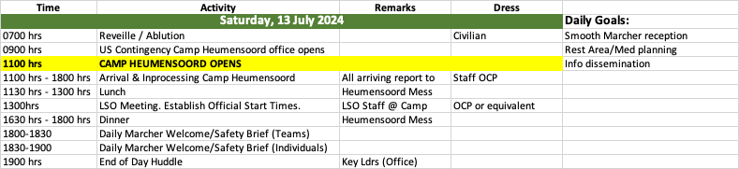
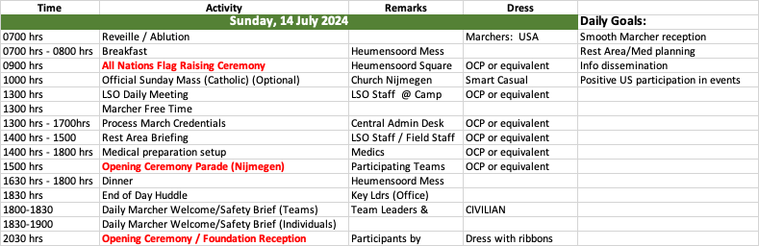
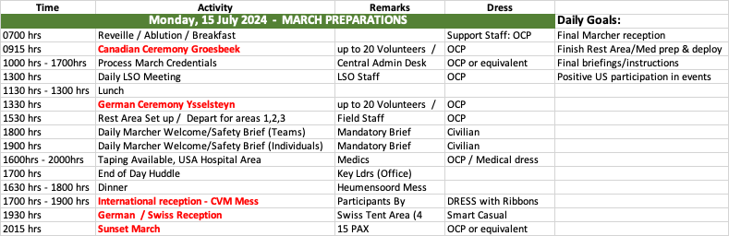
3. The March
3.1. Timeline – DRAFT ONLY, this is an update of the 2023 schedule. More to follow.
*
Sunset March: https://www.youtube.com/watch?v=AontzVy2BWA
Anthony Beevor cites 89 KIA, 151 WIA for both 82nd and Engineers, “The Battle of Arnheim“, Penguin Books, 2019, p.219.
* BULGER: this means YOU.
as of 20240510

Slide 8
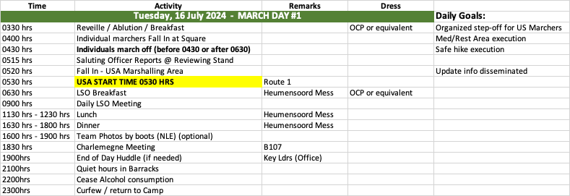
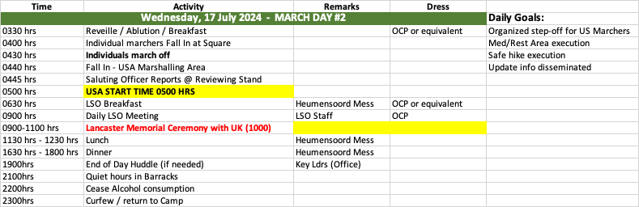
3. The March
3.1. Timeline (draft)
Route: Day of Elst
Route: Day of Wijchen
as of 20240510

Slide 9
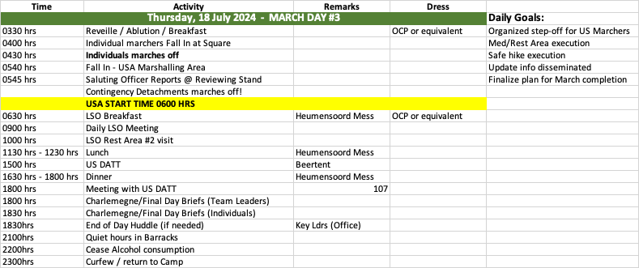
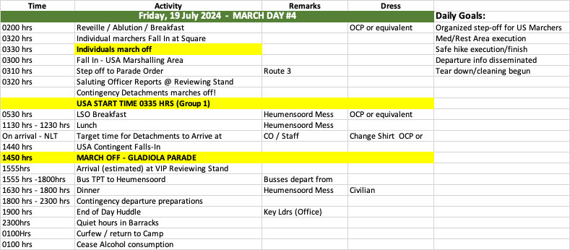

3. The March
3.1. Timeline (draft)
Route: Day of Groesbeek
*
Route: Day of Cuijk
* BULGER: this means YOU.
as of 20240510

Slide 10
3. The March
3.1. Timeline (draft) / Uniform / Duty Status
Past Step-Off Schedule
Day 1 – Tuesday, 18 July:
0430 - Individuals
0435 - Teams Group 1
0600 - Teams Group 2
Day 2 – Wednesday, 19 July:
0440 – Individuals
0530 – Teams Group 2
0600 – Teams Group 1
Day 3 – Thursday , 20 July:
0430 – Individuals
0500 – Teams Group 1
0530 – Teams Group 2
Day 4 – Friday, 21 July:
0330 – Individuals
0335 – Teams Group 2
0400 – Teams Group 1
Uniform
- We (USDNM) has no regulatory enforcement authority.
- Home units might set uniform policies. In practice, team leads set uniform standards. Individuals exercise independent
discretion.
- Blousing pantlegs is acceptable. Again: “match ambient traffic”.
- Any authorized uniform items may be worn. Combat shirts are fine.
- It is “nice” when teams look uniform... just saying.
Duty Status
- We (USDNM) have no authority over the source of marcher funds or duty status.
- Marchers/teams should verify their duty status prior to participation. USDNM cannot confirm/validate line-of-duty injuries.
- In general, the home unit/service has discretion. EUCOM is the proponent command, USAREUR-AF issues the OPORD, which
typically states that no unit funds may support marcher participation. Army Europe-Africa can speak for Army Europe-Africa.
- There is some unclarity to duty status. USAREUR-AF does allow PTDY, to authorize uniform wear without official support.
However, PTDY is legal only for officially- supported events, which might unit funding, so Nijmegen is not. … if no one makes this a problem, no one will have one.
- Reservists may participate in their “free time”. Nonetheless, please do clear your participation with your home command.
as of 20240510

Slide 11
3. The March
3.2. Routes
https://www.4daagse.nl/en/routes
Day 1 – Day of Elst https://www.4daagse.nl/en/routes/day-1
Day 2 – Day of Wijchen https://www.4daagse.nl/en/routes/day-2
Day 3 – Day of Groesbeek https://www.4daagse.nl/en/routes/day-3
Day 4 – Day of Cuijk https://www.4daagse.nl/en/routes/day-4
Conditions
- Course is entirely paved.
- Crowding can affect pace, plan accordingly.
- Weather – plan for sunshine, prepare for rain.
Water – water points, en-route refills, rest areas
Latrines – en-route, rest areas (… and, it’s Europe: be discrete, keep Nijmegen green. Everyone knows, nobody cares.)
Rest Areas – military rest areas are very clearly marked, are immediately past official mileage signs
- medical medics available (IF you have to fall out, best at rest area, easiest for later evacuation.)
- nutrition snacks only, not meals
- space co-located with UK, look for U.S. flag, and please remember space is limited
- Last Day – do I have to have a parade? The Via Gladiola.
as of 20240510

Slide 12
3. The March
3.3. Protocol / Etiquette / Alcohol
Protocol
- Return salutes of foreign officers only when passing reviewing stands.
Etiquette
- March in-step when passing reviewing stands. Teams march in formation.
- Wear full uniforms when passing through towns. Downgrade to undershirt is acceptable between towns. “Match ambient traffic.”
- Earbuds are discouraged, especially in towns and/or around crowds, though not prohibited. They are non-offensive on isolated
sections, but do recognize supporters along the route – they came there to see you, to cheer you on.
- Music is encouraged,* especially teams using speakers.
Alcohol
- Alcohol consumption is permitted in uniform on the march and in public. It is a traditional, social aspect of the event; and is not
frowned upon.
- However, public intoxication MAY compromise military bearing – especially in a public, multinational environment – and may lead
to UCMJ discipline at home unit.
- We (USDNM) may bar future Nijmegen participation for disorderly/unprofessional conduct of any kind.
2024 4Days Marches Regulations for Military Participants
https://www.4daagse.nl/cdn/3ef79aad-55a1-4ad7-9fdc-472c4567c20d/2024-4days-marches-regulations-for-military-participants.pdf
as of 20240510
*I love situation-specific playlists myself; here my vote for the „unofficial“ U.S. Nijmegen theme (I‘ve actually used it on the course):
https://www.youtube.com/watch?v=0BHuF2uN2HA

Slide 13
3. The March
3.4. “Fighting” Packing List
10kg Deadweight*
- Carry sufficient fixed weight IN ADDITION TO variable food/water mass.
- The pack weight counts against the total 10kg.
- There “should” be a baggage scale at the U.S. Delegation Office for weigh-in.
- Sand is available at Heumensoord for deadweight.
Boots
bring 2x pair to Nijmegen, alternate daily
size is one size larger than “nominal” foot size
RECOMMEND - 2x insoles*
Socks
at least 2x boot socks each day*
RECOMMEND – wool socks. NOT cotton (meaning Clothing & Sales issue)
Headgear
RECOMMEND - boonie hat over patrol cap
Underwear
Spandex - thigh-length to mitigate chaffing (better: lose weight).
Wet weather
Always bring rain gear. Jacket sufficient; poncho can cover pack, too (and is 0.7kg against your deadweight).
Miscellany
Hand exerciser*
Speakers – earbuds are discouraged
Battery Packs
* Variability is very helpful in mitigating the repetitive injuries common to endurance events like Nijmegen.
as of 20240510

Slide 14
4. Training
4.1. Training Approach
By Army definition, the Nijmegen is (1) an administrative, (2) forced foot march. This endurance event exceeds the demands of doctrinal tasks and training regimens. Training falls between operational and personal self-development domains. Training must expand upon available, proven techniques. Success at Nijmegen very likely indicates a level of personal fitness that will meet/exceed Army fitness requirements. Success at other events does not indicate readiness for Nijmegen, however. In addition to contributing to personal readiness, perhaps the greatest benefit of Nijmegen is the months-long experience of “training like you train”. This is a foundation prerequisite for “training like you fight”. The kind of injuries suffered at Nijmegen are the most common in the Army by far. The experience of successful Nijmegen training can benefit individuals, units, and organizations - if done well.
NIJMEGEN
as of 20240510

Slide 15
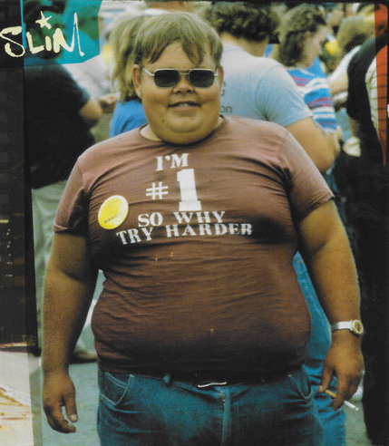

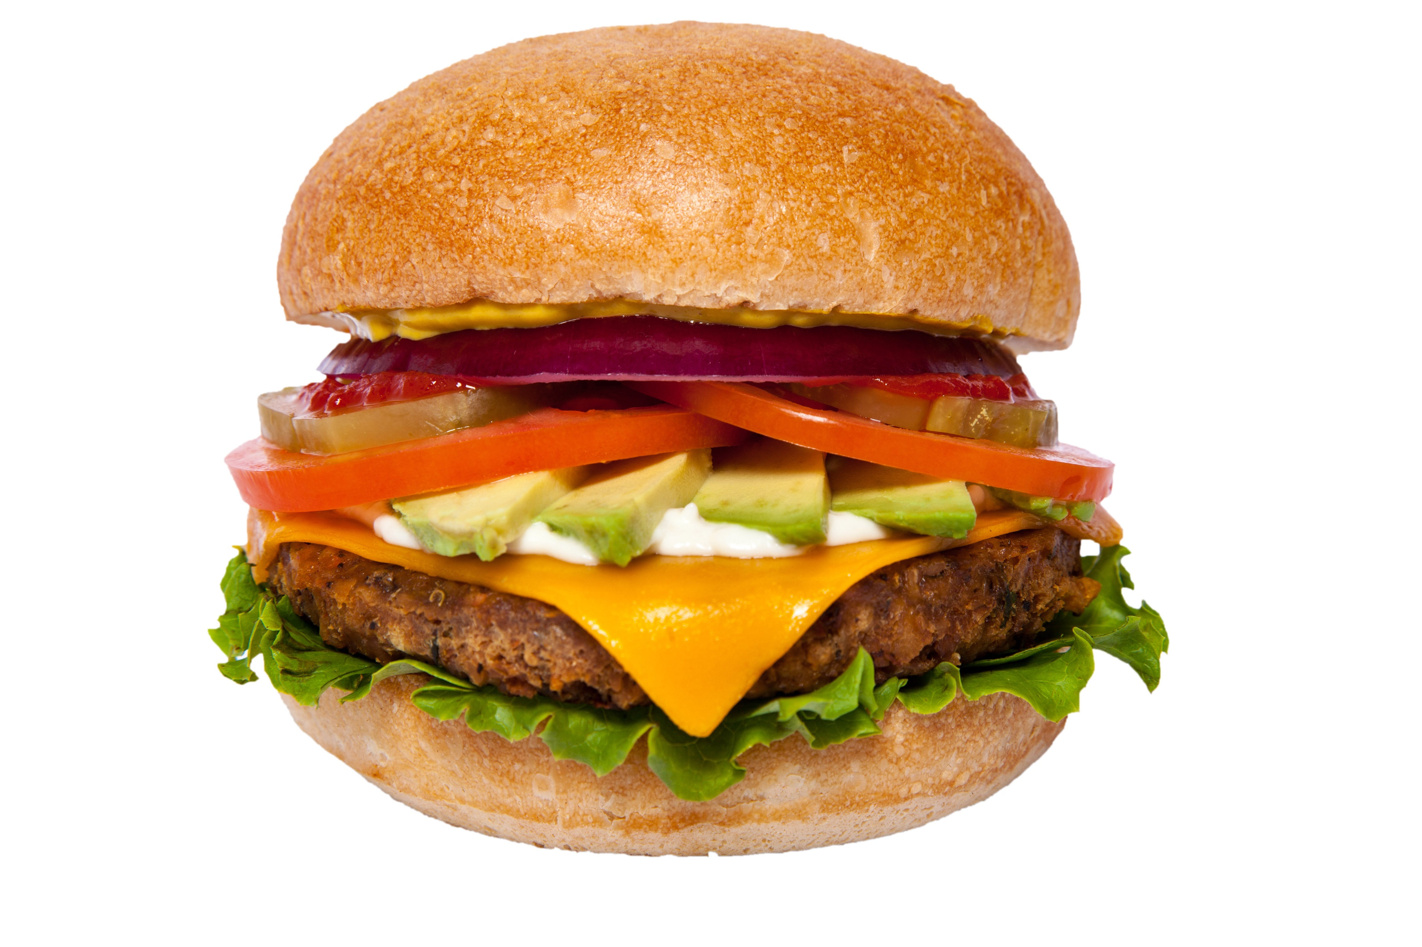
4. Training
4.2. References
- Title10, United States Code, Section 3013(b)(5) – Sec Army to train force
- Army Regulation (AR) 350-1, Training and Leader Development, 20171210
- The Army Training Strategy, 20121003
- Army Doctrinal Publication (ADP) 7-0, Training, 20190731
- Field Manual (FM) 7-0, Training, 20160614
- FM 7-22, Holistic Health and Fitness (H2F), 20201008
- Army Techniques Publication (ATP) 7-22.02, H2F Drills and Exercises, 20201001
- ATP 3-21.18, Foot Marches, 20220413
- Military Running https://militaryrunning.com
- Warfigher Nutrition Guide https://www.hprc-online.org/nutrition/warfighter-nutrition-guide
- Warfighter’s Guide to Performance Nutrition and Operational Rations https://quartermaster.army.mil/jccoe/Operations_Directorate/QUAD/docs/Warfighters-Guide-to-Performance-Nutrition-and-OpRats-1st-edition.pdf
- Guide to Nutrient Timing: The basics https://www.hprc-online.org/sites/default/files/2020-01/HPRC_Nutrient_Timing_Basics_011620.pdf
All Army doctrine is downloadable through Army Publishing Directorate at
https://armypubs.army.mil
4.3. Training Considerations
- Posture – Pose method – from physical therapy, this is now Army doctrine
- Breathing – nasal, head up
- Nutrition – food and hydration… salty peanuts and electrolytes
- Strength versus AND Endurance
- Schedules
There is no substitute for time-on-trail: you must do the distance.
“A foot march is successful when Soldiers arrive at their destination at the prescribed time and are physically and mentally able to execute their mission immediately” […so: via Gladiola] (ATP 3-21.18, 1-2).
as of 20240510

Slide 16

5. Execution
5.1. Warm-up
- yoga stretches
- ATP 7-22.02 warm-up drills
… or just start – ease into it
5.2. Resting
- take breaks to increase tempo
- ATP 3-21.18 recommends 10 minutes every hour. The Germans do something like this... and generally do best.
- monitor hydration and nutrition… bananas, beer… and salty peanuts
5.3. Cool-down
- Remember to cool down! DO NOT just stop. Cooling down washes out accumulated waste, aiding recovery – hence
“recovery” drill.
- Run one lap around Heumensoord
at slowest possible pace.
- yoga stretches
- ATP 7-22.02 recovery drills
- foam roller
- foot bath
…
- eat
- sleep
as of 20240510

Slide 17
Conclusion
Questions?
Comments!
as of 20240510

